Slide 1
Assignment Expectations
Honors Integrated Science
M. Fenton

Slide 2
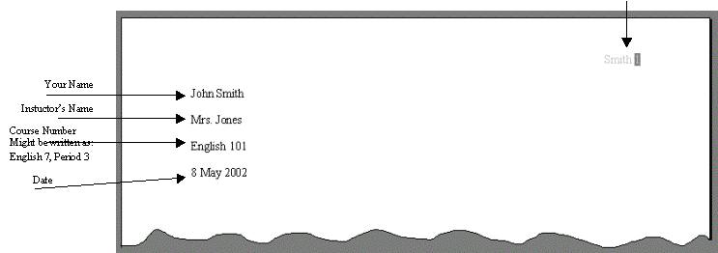
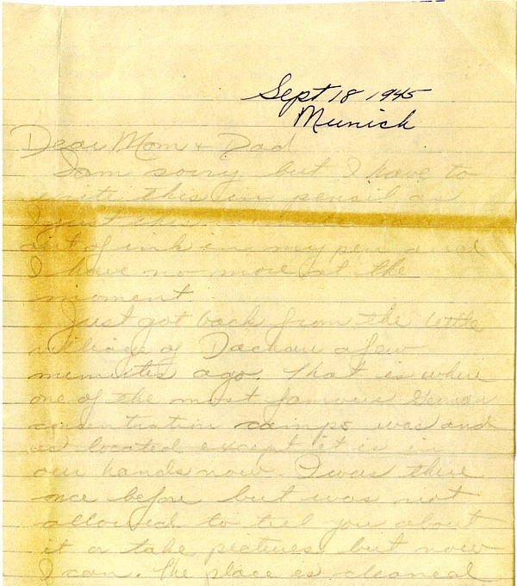
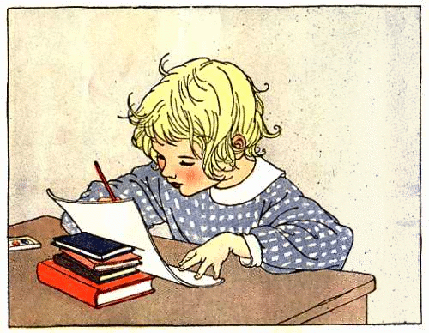
All Work
2 + pages:
Smith 2
Upper LEFT corner
I can’t read this!
“#2. It gets hotter..”
What does?
Follow MLA rules, write in blue/black ink (or type), use complete sentences

Slide 3
Vocabulary: definitions
Define 20+ in your own words
Glossary says : “Adenosine triphosphate; energy-storing molecule that serves as the cells ‘energy currency’; stored energy of glucose is used to attach phosphate groups to ADP to form ATP”
Huh??
• Your definition: Energy converted from glucose,
used by cells. ADP + P > ATP

Slide 4
example definitions
yes
no
Observation –Something noticed by the senses; facts, not inferences
Inference – A guess using what you know
Quantitative- estimable according to quantity
Experiment - test
Huh??

Slide 5
Vocabulary: assertions
Write at least 12 assertions using the vocabulary
Each assertion relates 2 terms from your vocabulary list
An independent variable causes a change in the dependent variable
Use conjunctions to show relationships: causes, but, although, however, before, unless, when, since…
F A N B O Y S
For And Nor But Or Yet So
Notes:
The purpose of a conjunctive adverb is to show a relationship between clauses such as comparing or contrasting, showing a sequence of events, or showing a cause and effect.
Accordingly
Additionally
Also
Besides
Comparatively
Consequently
Conversely
Finally
Further
Furthermore
Elsewhere
Equally
Hence
Henceforth
However
In addition
In comparison
In contrast
Indeed
Instead
Likewise
Meanwhile
Moreover
Namely
Nevertheless
Next
Nonetheless
Now
Otherwise
Rather
Similarly
Still
Subsequently
Then
Thereafter
Therefore
Thus
Yet

Slide 6
example assertions
yes
no
The independent variable determines the outcome of the dependent variable
A theory is not quite a fact for one of its requirements is that it must be falsifiable.
Qualitative and quantitative are two different kinds of data.
Since he did not observe her car, John inferred that Jane was not home

Slide 7
conjunctions = more complex writing
after
although
as
also
additionally
as long as
because
before
besides
causes
determines
finally
how
hence
however
in comparison
in contrast
instead
in order
in case
once
provided
rather than
since
so
similarly
still
than
then
that
though
therefore
thus
unless
until
whereas whether
what when where which

