Slide 1
MAINTAINING HOMEOSTASIS
All organisms must be able to detect changes in the environment
internal changes as well as changes in external environs
Detect and register stimuli, generate a response as needed
Essential in organism development, growth, reproduction, metabolism, and homeostasis

Slide 2
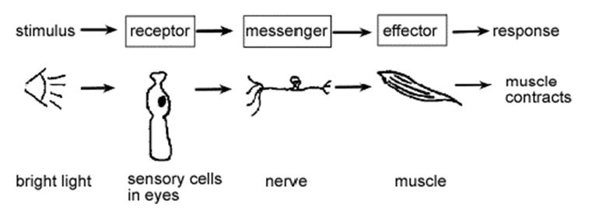
System-Wide Communication
via nervous & endocrine systems
cell
(neuron)

Slide 3
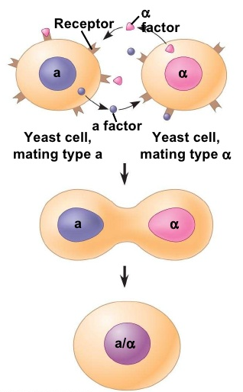
Communication Between Cells
Stimulus/response also allows for cell to cell communication
Ex: Yeast Mating
Stimulus: each of two cells (a, ‘α’ ) release a signal molecule (‘factor’) that binds to the membrane receptors of the other cell
Response: the fusion of the 2 cells, including their nuclei, creating a diploid cell
requires a process for moving the message within the cell
a diploid cell
(2 sets of DNA)
Ex: quorum sensing of bacteria

Slide 4
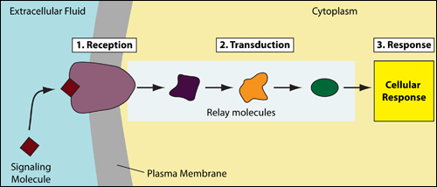
Communication Within a Cell
aka Signal Transduction
Translating external stimulus into a cellular response
The signal molecule at the membrane receptor signals internal relay molecules, ultimately eliciting the cellular response
1. Signal molecule interacts with receptor, opens gated channels, etc
3. Activate a gene,
move a cell, secrete a protein, etc
2. Activates inactive secondary signal molecules which transform, conduct the message
Notes:
Mechanism largely the same in all organisms, pointing to common ancestry, ue to this being a highly conserved process

Slide 5
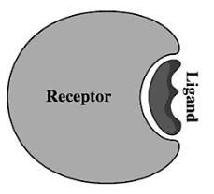
Signaling molecules
AKA ligands
Chemical messengers
Includes: hormones, growth factors, pheromones, neurotransmitters
Recognized by & physically fit with specific membrane receptors

Slide 7
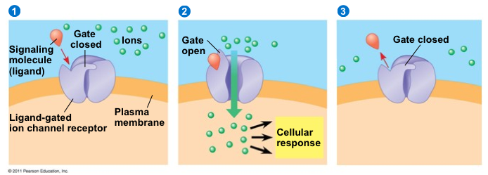
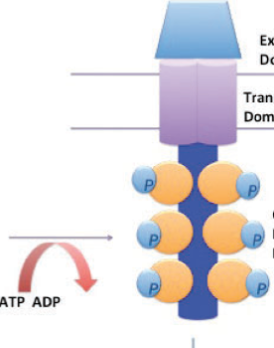
Ligand modifies the Receptor
Interaction of signal molecule and receptor causes a change in receptor conformation
transferring a phosphate from ATP – phosphorylation – is often involved
signal molecule
membrane receptor
phosphates
ATP

Slide 8
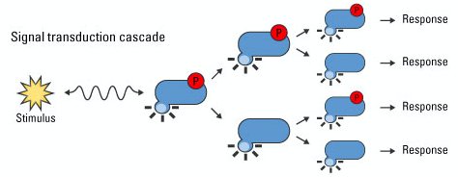
Transduction relays the signal
Moves the message within the cell. Employs secondary messenger molecules, i.e. cAMP
Transduction phase can involve activating enzymes (kinases are common), phosphorylation, rearrangement of the cytoskeleton, amplification of the message, and more.
cAMP
cascade
Notes:
cAMP = cyclic adenosine monophosphate

Slide 9
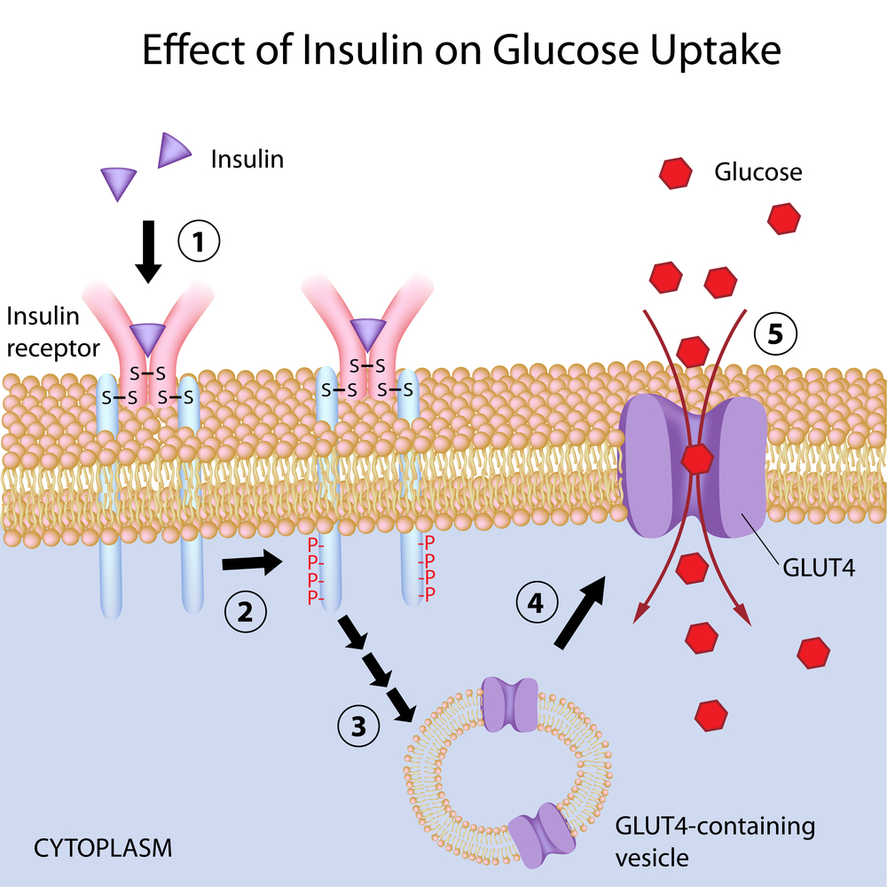
Example: glucose uptake
1. Insulin ligand as signal
2. Phosphorylation of receptor
3. Transduction of message to effector: vessicles w/GLUT4 proteins
4. GLUT4 glucose proteins inserted in PM as channels in response; glucose can enter cell
Notes:
Insulin binds to the insulin receptor (1); Receptor is activated, causing a conformation change known as dimerization (the coming together of two insulin receptors). Receptor adds a phosphate to amino acids (tyrosines) on the tail of the other insulin receptor in the pair (2). Signal transduction proteins interact with phosphate group (3). Interaction of the phosphate groups with all of the di erent signaling proteins occurs simultaneously, but each pathway will be discussed individually. Signaling proteins and pathways will cause the short-term and long-term changes in response to the increased glucose in the blood stream. One major short-term change is the fusion of vesicles containing glucose transporter (GLUT4) to the cell membrane (4). Once these transporters are part of the cell surface, glucose is transported into the cell (5).
Long-term cellular changes are caused by changes in gene transcription that result in speci c proteins being made or not made. These pathways utilize many di erent signaling patterns, such as the direct activation of a transcription factor (T.F.) (6), the release of second messenger (7), and the activation of a kinase cascade (8). All of these signaling pathways can result in the activation of transcription factors and their movement to the nucleus to activate transcription (9).

Slide 10
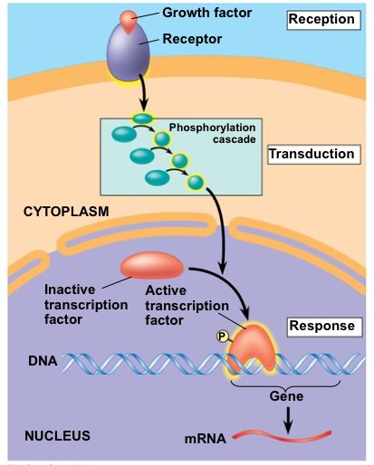
Example: Transcription
Signal at PM, transduction in cytoplasm to activate transcription of DNA in nucleus.
Response is the production of mRNA

Slide 11
Changes to signal transduction pathway can change cellular response
A blocked transduction pathway can cause disease
p53 acts as a tumor suppressor gene; when carcinogens mutate p53, it causes an excessive amount of growth-promoting signal molecules, leading to rapid and uncontrolled cell division
Or be an intentional strategy in treatments
Antihistamines block the binding of the histamine, preventing the increase in vascular permeability that causes runny nose, watery eyes
BCP hormones blocks transduction by inhibiting the molecules that cause ovulation (negative feedback)
Notes:
Mast cells release histamine in response to pollen, allergens

Slide 13
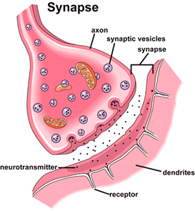
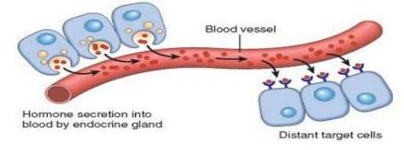
Signaling Near and Far
Between cells in close proximity…
… or long distance
Neuron synapse
paracrine
Plant plasmodesmata
juxtacrine
Hormones communicate with distant target cells via blood
endocrine

Slide 15
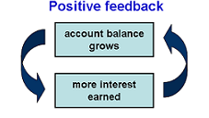
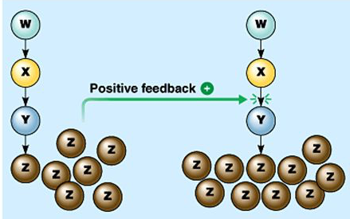
FEEDBACK
Stimulus causes a change in the same direction
more
more

Slide 16
Examples: Positive Feedback
The number of prey increases > number of predators increase
A baby pushes on the cervix in childbirth > oxytocin released > uterine muscles contract > more pushing on cervix > more oxytocin
Nursing > release oxy > milk ‘letdown’ > more nursing > more milk produced
Cells near a cut activates platelets > platelets activate more platelets, to stop the bleeding

Slide 17
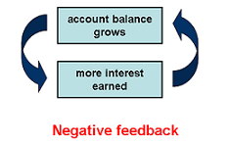
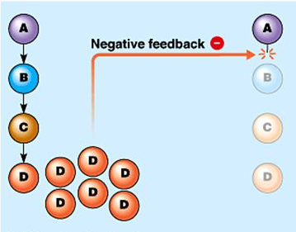
FEEDBACK
Stimulus causes a change in the opposite direction
more
less

Slide 18
Examples: Negative Feedback
Dehydration > drop in BP > release antidiuretic hormone (ADH) > kidney reabsorbs water > BP comes back up
Enzyme PFK > generates ATP from glucose in glycolysis > ATP binds to allosteric site on PFK > glycolysis slows
When the number of predators increases > # prey decrease
Hungry > metabolism slows > conserves energy > less need for food

Slide 20
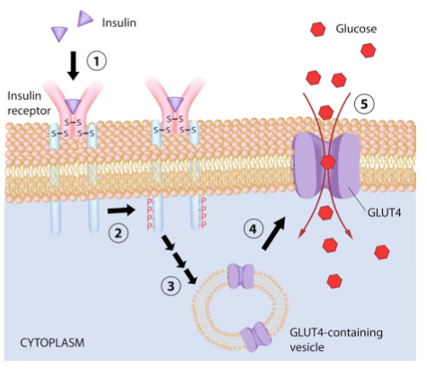
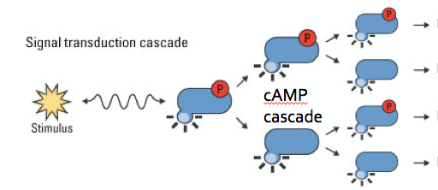
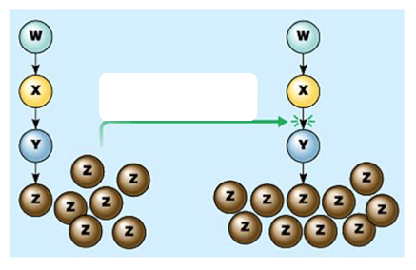
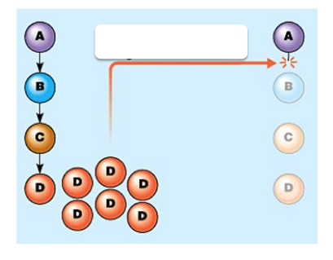
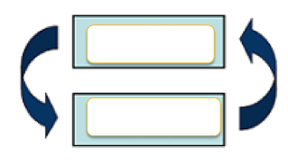

Slide 21
