Slide 1
Meiosis & Sexual Reproduction
AP Biology

Slide 2
Why sexual reproduction?
Asexual repro
Sexual repro
Faster, simpler
higher success rate
However, organisms are not very varied
populations are less able to respond successfully to changes in the environment
Creates variation
thus increasing population viability
population more likely to tolerate environmental change
But at a cost
time
increased error potential

Slide 3
Sources of variation
Via mutations
in replication (both sexual and asexual approaches)
chromosomal mutations during gamete (sex cell) production
Via meiosis – creates varied gametes
random arrangement on cell equator during metaphases
crossing over mixes up homologous chromosome DNA
Gametes come from different sources (parents)
Random gametes come together in fertilization

Slide 4
Why is meiosis necessary?
Cells combine– vs dividing - in sexual reproduction
Need to keep the species chromosome number constant between generations
Can’t have chromosomes double each generation!
Therefore, each gamete can only contain half the DNA of a body cell
Germ cells (in ovary, testes) use meiosis to make gametes: DNA replication & 2 DNA divisions
[Somatic (body) cells use mitosis: DNA replication & 1 DNA division]

Slide 5
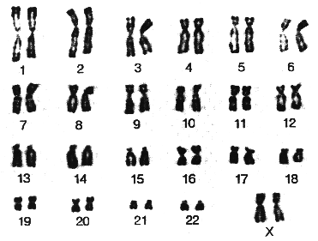
Somatic (body) cells of humans have 46 chromosomes – two sets of 23 (diploid)
A karyotype
autosomes
sex chromosomes
XX
XY

Slide 6
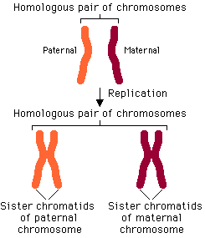
The paired chromosomes are homologous*
same size, shape, genes, but not necessarily same alleles
*all but X, Y pair
1 from each parent
A homologous pair
• post-replication
• paired chromatids

Slide 7
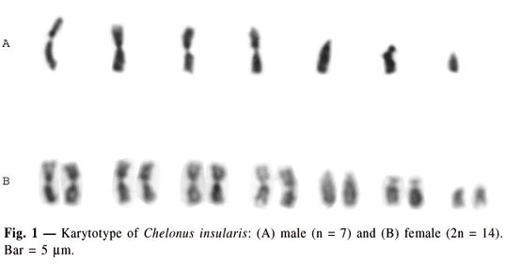
n is the number of unique chromosomes per species
n = 7: a haploid cell; a gamete
2n = 14: a diploid cell; a somatic (body) cell

Slide 8
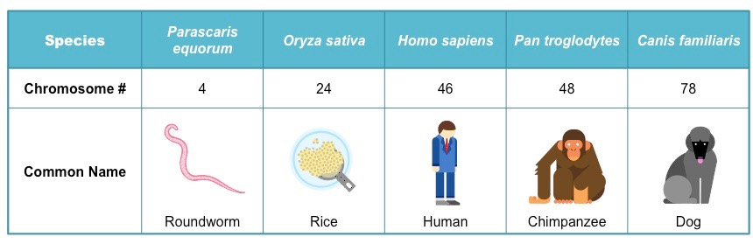
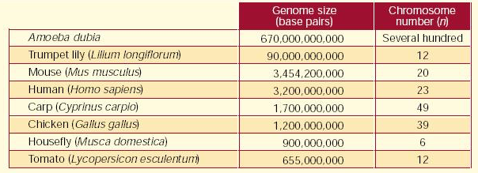
Chromosome number is not correlated with complexity of species, or genome size
2n

Slide 9
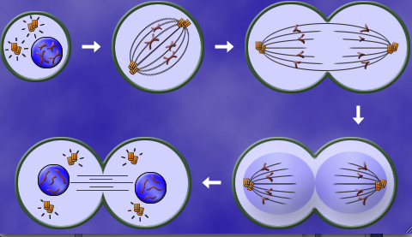
MITOSIS produces somatic (body) cells
2. DNA is replicated
3. DNA (chromosomes) divides
1. One parent cell
4. Two daughter cells, identical to parent and to each other
1 DNA replication
1 DNA division

Slide 10
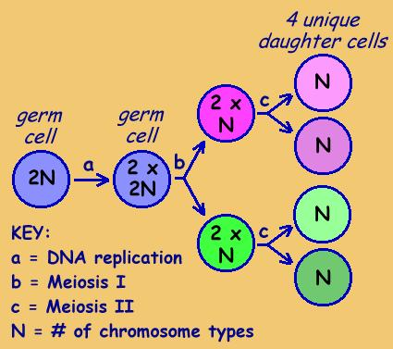
Gametes are produced via MEIOSIS
4 haploid daughter cells
gametes :
4 sperm
or
1 ovum + 3
polar bodies
Diploid germ cell in ovary or testes

Slide 11
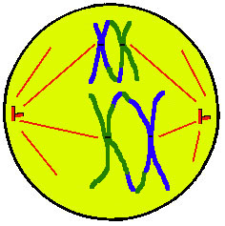
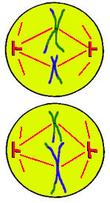
In MEIOSIS, DNA divides twice, to reduce
the chromosome number of the gametes
First in homologous pairs…
…then just as in mitosis for the second division

Slide 12
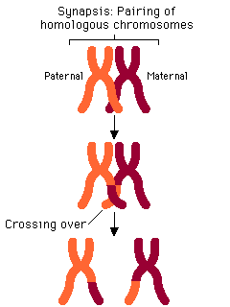
The homologs are so close together, crossing over occurs, increasing variation
Each gamete created from these 4 chromatids has a unique combination of the genes on this chromosome
gametes

Slide 13
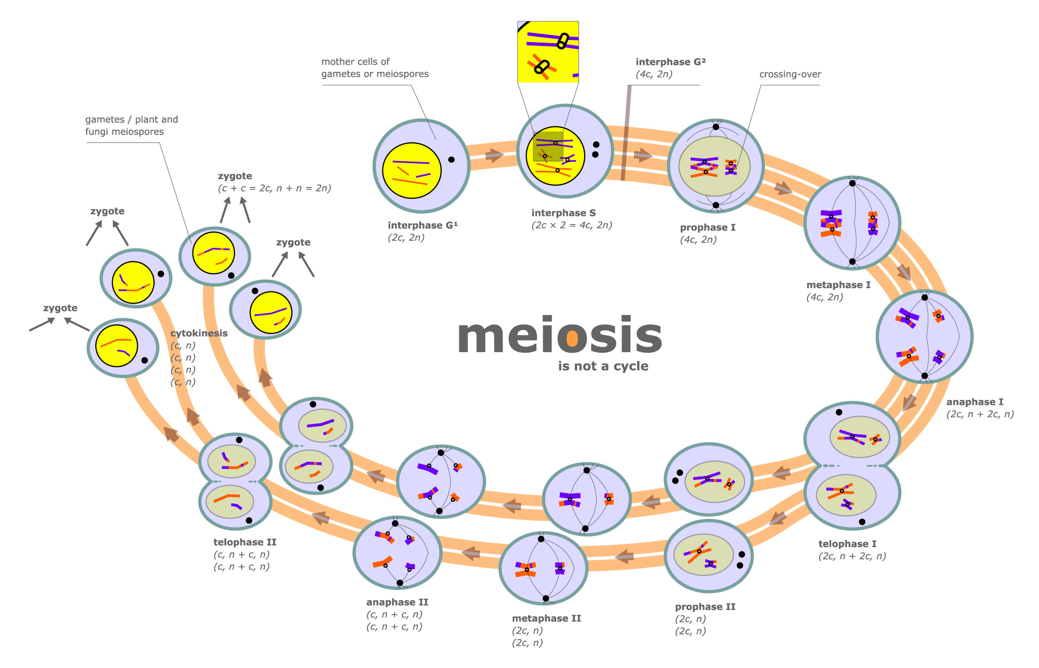
synthesis
M1
4 haploid gametes
I
homologs pair, separate
sister chromatids separate
M2

Slide 14
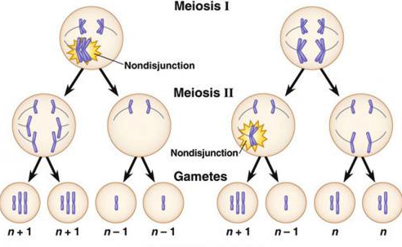
Chromosomes sometime fail to separate
aka nondisjunction
fatal in mitosis; most are fatal in meiosis
exceptions: Downs, Patau, Edwards syndromes; X/Y errors
Notes:
If the non-sex chromosomes (autosomes) fail to separate properly, the results are usually fatal and the pregnancy is not carried out. When autosomal non-disjunctions do lead to birth, the individual will carry a third chromosome. Trisomy 21 causes Down syndrome. Trisomy 13 results in Patau syndrome. Trisomy 18 leads to Edward's syndrome. Other more severe chromosomal abnormalities that are rarely carried to term include extra copies of chromosomes 15, 16, and 22.

Slide 15
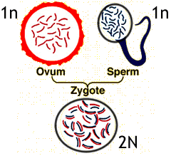
Even more genetic variation is achieved when gametes come together
Haploid gametes
join creating a…
n?
…diploid zygote

Slide 16
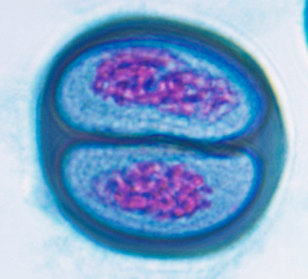
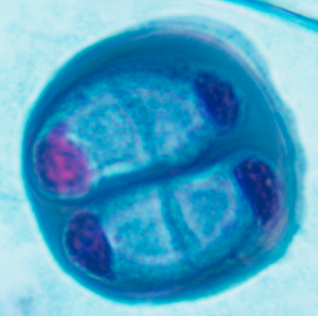
Telophase I Telophase II

Slide 18
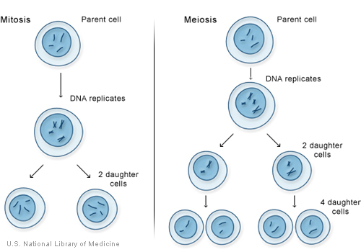
Mitosis
Meiosis
diploid parent cells
2 diploid cells formed
4 haploid cells formed

Slide 19
Mitosis v meiosis
Cells Alive:
http://www.cellsalive.com/mitosis.htm
http://www.cellsalive.com/meiosis.htm
Mitosis v meiosis
http://www.pbs.org/wgbh/nova/miracle/divide.html

