Slide 1
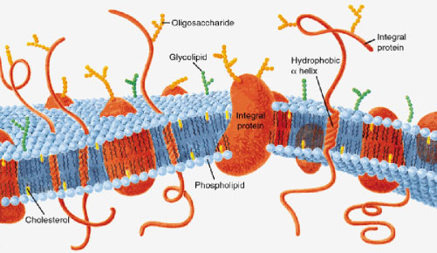
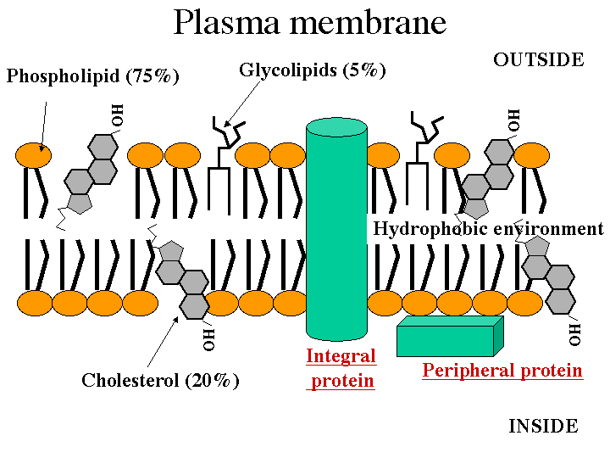
separates cell from environment
Plasma Membrane
The
fluid, mosaic, bilayer, model
Singer, Nicolson 1972

Slide 2
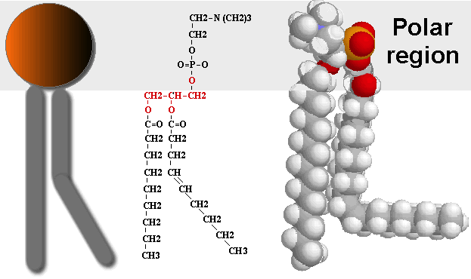
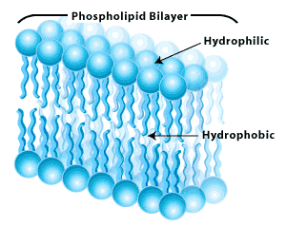
The plasma membrane is built of phospholipids
Charged phosphate ‘head’
Hydrophobic H-C tails
self-organizes into a bilayer
Based on affinity to aqueous cytoplasm, aqueous environment

Slide 3
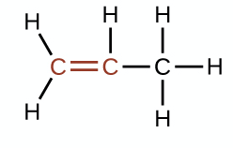
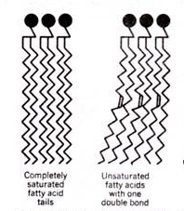
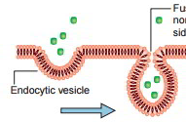
The plasma membrane is fluid
double bonds create unsaturated lipids
creates ‘kinks’ in phospholipid H-C tails
therefore phospholipids do not pack together too tightly
allows the membrane to change shape, other molecules in membrane to move about

Slide 4
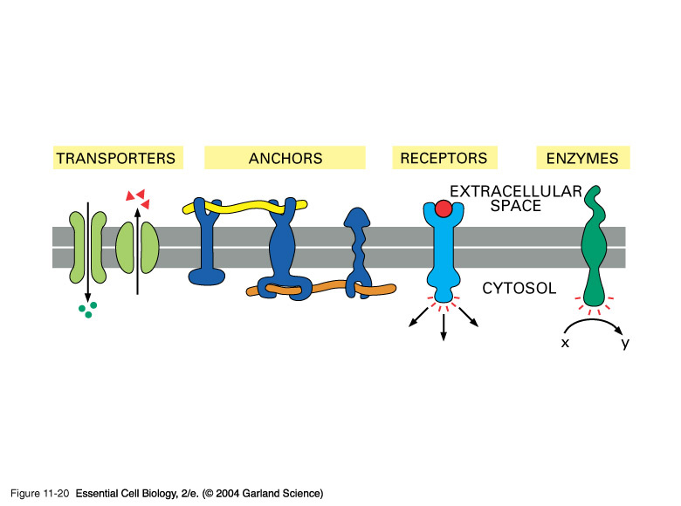
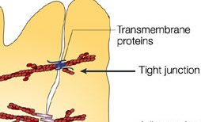
The plasma membrane is a mosaic, the phospholipid layers embedded with proteins, lipids, carbohydrates
membrane stability
facilitate rxns
bind cells together
move molecules across
relay information
in/out of cell

Slide 5
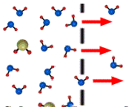
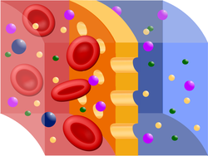
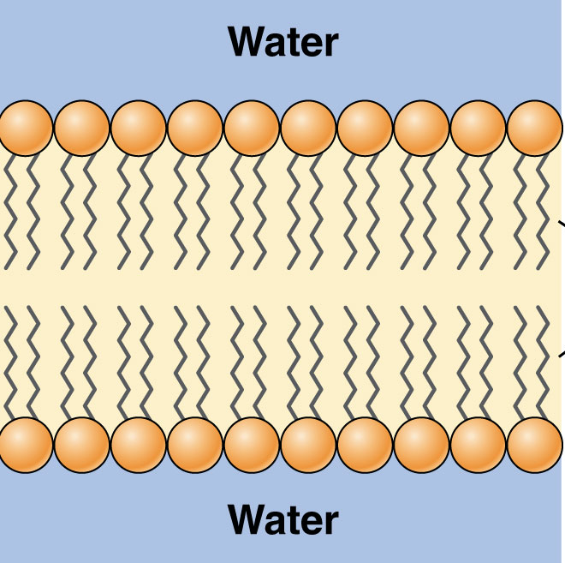
Membranes can impede diffusion
• despite a concentration gradient
• aka: semi-/selectively permeable
Factors:
molecule size
molecule charge
HYDROPHOBIC

Slide 6
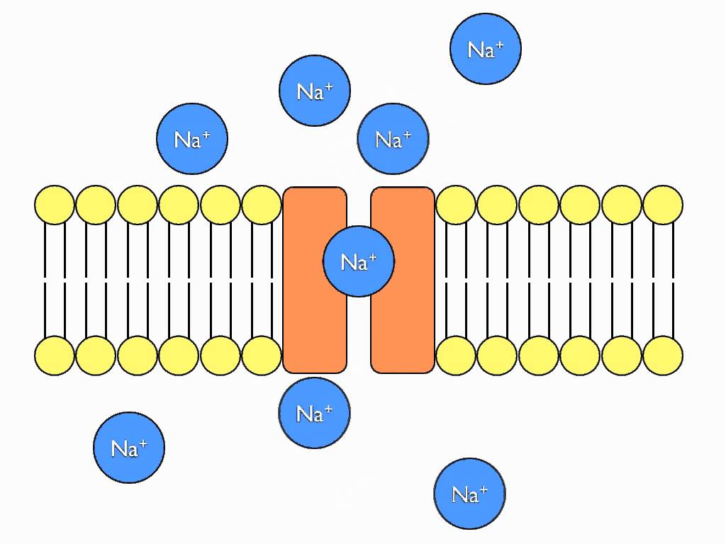
Membrane Proteins aid diffusion
• form channels and carriers to allow the movement of
large or charged molecules across plasma membrane
Still a passive transport mechanism/no cell ATP required
animation

Slide 7
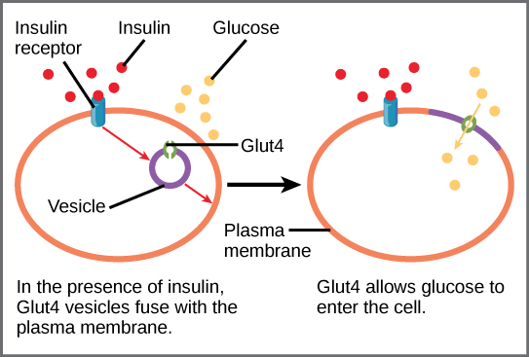
• Membrane protein receptors recognize insulin in blood, signal the movement of glucose-specific transport proteins to the plasma membrane.
• Thus glucose diffuses through the proteins from higher concentration in the blood to the lower concentration of cells
1
2
3
EX:
5
4
6

Slide 8
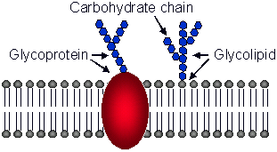
Membrane Carbohydrates
• cell to cell attachment
• cell recognition
• cell signaling (communication)

Slide 9
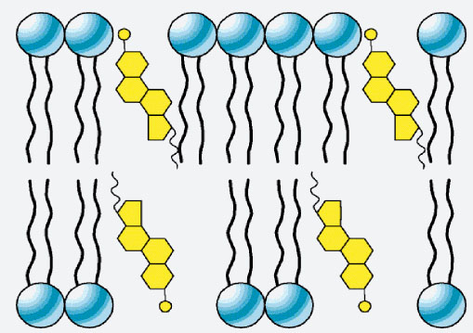
Membrane Cholesterol
Cholesterol manages membrane fluidity
• In warm temperatures, cholesterol adds rigidity
• In cold temps cholesterol adds fluidity, keeps
membrane from freezing
cholesterol

