Slide 1
Standard Error of the Mean
The mean and SD we calculated are based only on a sample - How confident can we be that it accurately represents the mean of the entire population?
64 81 94 88 31 93 85
76 80 80 83 81 84 85
89 72 85 69 72 90 75
77 82 90 65 70 86 80
Notes:
I taught SEM as tool a biologist would use to compare the means of different samples; that is if you find that acorns of a sample from one population have an average mass different from those from a second population, you should compare the two means based on the range of likely values the SEM provides. The mean of a sample with a large SD, or small in size, is more likely to be in error, thus a larger error bar. If the SEM overlap, the two samples, despite their different means, may not be different. This is what (b) asks, I believe. And this is what my kids did in lab.

Slide 2
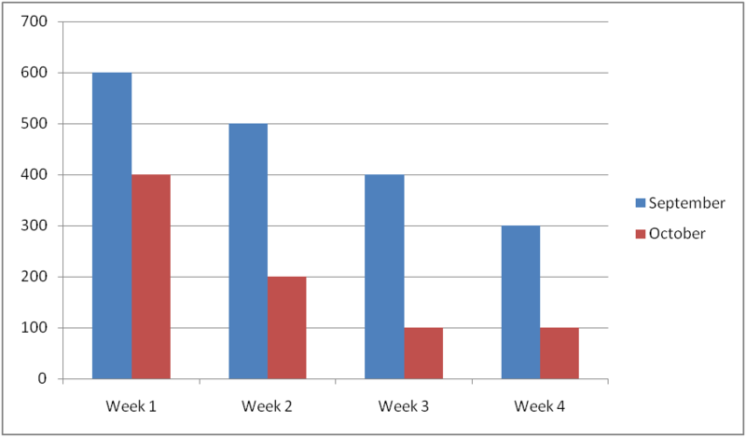
SEM is useful for making comparisons between data sets beyond visual impressions
looks like a difference… but is it?
Notes:
In biology, to describe a population
In education to calculate a grade curve
In production systems as the upper and lower control limit; anything above or below represents a problem.
In finance, the higher the standard deviation, the riskier the investment
For sports teams, a high standard deviation shows that they perform well in some situations but not in others.
Regarding climate while two cities may each have the same average maximum temperature, the standard deviation of the daily maximum temperature for a coastal city will be less than that of an inland city

Slide 3
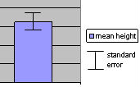
• The standard error of the mean (SEM) is an estimate of how close the sample mean is likely to be to the true mean, the mean if we measured the entire population
• The SEM is added to the bar of each mean in a graphed comparison. It tells the range of values that the true mean will fall in, based on the SD
mean of sample group
range of values the true mean is in
Notes:
I taught SEM as tool a biologist would use to compare the means of different samples; that is if you find that acorns of a sample from one population have an average mass different from those from a second population, you should compare the two means based on the range of likely values the SEM provides. The mean of a sample with a large SD, or small in size, is more likely to be in error, thus a larger error bar. If the SEM overlap, the two samples, despite their different means, may not be different. This is what (b) asks, I believe. And this is what my kids did in lab.
However, (a) asks for an entirely different use of the SEM. Confidence intervals reflect how well the sample mean reflects the true mean of the entire population. I think this gets into z-scores, where +/- 1.96 SEM = 95% confidence; 95% of samples would include the true mean within their SEM(+/- 1.96). (thank you college-student son home on break!) But seeing as they defined what to do (multiply the SEM provided by 2 - a rounding of the 1.96?), did they not expect the kids to know it? Just ignore that foreign wording and multiply the SEM by 2?

Slide 4
• If the standard error bars overlap, this data is not sufficient evidence of a difference in the population means, and therefore in the two populations.
• Not statistically significant differences
Notes:
I taught SEM as tool a biologist would use to compare the means of different samples; that is if you find that acorns of a sample from one population have an average mass different from those from a second population, you should compare the two means based on the range of likely values the SEM provides. The mean of a sample with a large SD, or small in size, is more likely to be in error, thus a larger error bar. If the SEM overlap, the two samples, despite their different means, may not be different. This is what (b) asks, I believe. And this is what my kids did in lab.
However, (a) asks for an entirely different use of the SEM. Confidence intervals reflect how well the sample mean reflects the true mean of the entire population. I think this gets into z-scores, where +/- 1.96 SEM = 95% confidence; 95% of samples would include the true mean within their SEM(+/- 1.96). (thank you college-student son home on break!) But seeing as they defined what to do (multiply the SEM provided by 2 - a rounding of the 1.96?), did they not expect the kids to know it? Just ignore that foreign wording and multiply the SEM by 2?

Slide 5
• If standard error bars do NOT overlap, this is sufficient evidence of a difference in the population means, and therefore in the two populations.
• Statistically significant differences
Notes:
I taught SEM as tool a biologist would use to compare the means of different samples; that is if you find that acorns of a sample from one population have an average mass different from those from a second population, you should compare the two means based on the range of likely values the SEM provides. The mean of a sample with a large SD, or small in size, is more likely to be in error, thus a larger error bar. If the SEM overlap, the two samples, despite their different means, may not be different. This is what (b) asks, I believe. And this is what my kids did in lab.
However, (a) asks for an entirely different use of the SEM. Confidence intervals reflect how well the sample mean reflects the true mean of the entire population. I think this gets into z-scores, where +/- 1.96 SEM = 95% confidence; 95% of samples would include the true mean within their SEM(+/- 1.96). (thank you college-student son home on break!) But seeing as they defined what to do (multiply the SEM provided by 2 - a rounding of the 1.96?), did they not expect the kids to know it? Just ignore that foreign wording and multiply the SEM by 2?

Slide 6
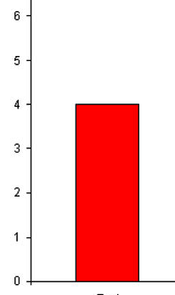
The SEM can be used to produce confidence intervals
68% confident the true mean is between +/- 1 SEM.
+ 2 SEM
- 2 SEM
+1 SEM
- 1 SEM
95% confident the true mean is between +/- 2 SEM
Hint: these % confidence are the same as the % for +/- SD!
Notes:
However, (a) asks for an entirely different use of the SEM. Confidence intervals reflect how well the sample mean reflects the true mean of the entire population. I think this gets into z-scores, where 95% confidence; 95% of samples would include the true mean within their SEM(+/- 1.96). (thank you college-student son home on break!)

Slide 7
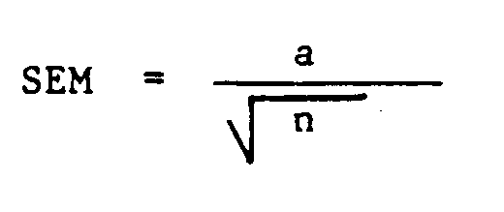
CalCULATE SEM
S
S
standard deviation
sample size

Slide 8
Practice #1
Blood cholesterol levels were measured in a population sample of 1100 men.
The mean for the sample was μ= 188 mg/dL
with a standard deviation σ = 24.
• Solve for the SEM
• Determine the min & max of blood pressure values that reflects a confidence interval of 95% (+/- 2 SD) of the sample population.
Notes:
Men: 188 - .72 = 186.56 188 + 1.44 = 189.44

Slide 9
Practice #2
A similar study was performed on a sample of 87 women.
The mean for that sample was μ= 201 mg/dL
with a standard deviation σ = 17.
• Which sample mean – men or women - has the greatest likelihood of error? Justify.
(men’s data: n= 1100
mean =188
SEM = 24)
Notes:
Women: 201 – 1.82-1.82 = 197.36 201 + 3.64 = 204.64

Slide 10
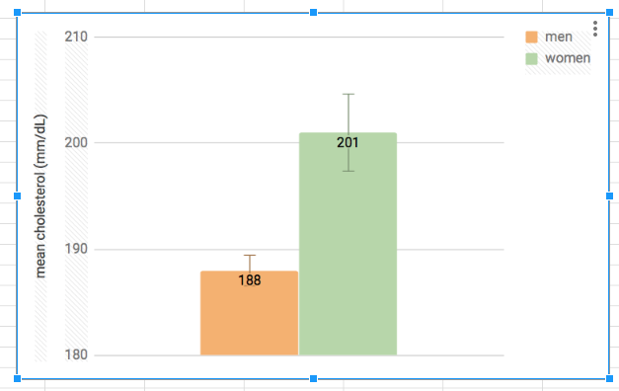
Same or different?
- 3.64
+ 1.44
n= 1100 n = 87
Notes:
Men: 188 - .72 = 186.56 188 + 1.44 = 189.44
Women: 201 – 1.82-1.82 = 197.36 201 + 3.64 = 204.64

Slide 11
What is the effect of sample size (n)?
SE = 22/sqrt 47
= +/- 3.23
smallest sample
largest sample
SE = 22/sqrt 147
= +/- 1.81
SE = 22 sqrt 1147
= +/- 0.65
• What should a biologist do to increase confidence in the sample mean?

