Slide 1
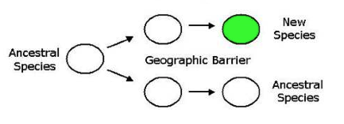
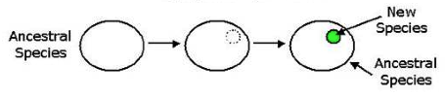
FORMING NEW SPECIES FROM EXISTING ONES HINGES ON REPRODUCTIVE ISOLATION
Allopatric speciation
• Geographically isolated, therefore reproductively isolated
Sympatric speciation
• Less common; reproductively isolated based on behavior, etc

Slide 2
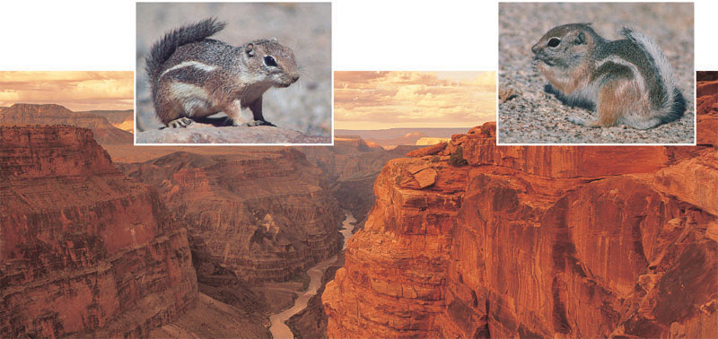
ALLOPATRIC SPECIATION illustrative example: desert squirrels
A. harrisi
A. leucurus
One or both populations may undergo genetic change
via selection or drift – divergent evolution

Slide 3
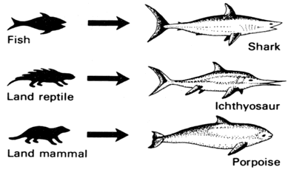
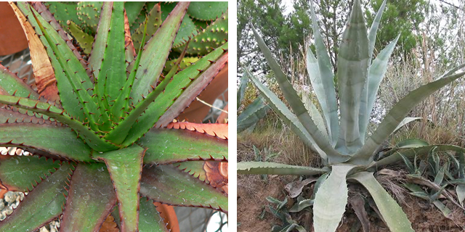
[In contrast: convergent evolution – different evolutionary paths yield similar organisms]
Aloe broomii, Africa
Agave Americana Mexico, US
Distant common ancestor (93mya) yet both adapted for a dry climate (spiny leaves, succulent leaves, CAM photosynthesis)

Slide 4
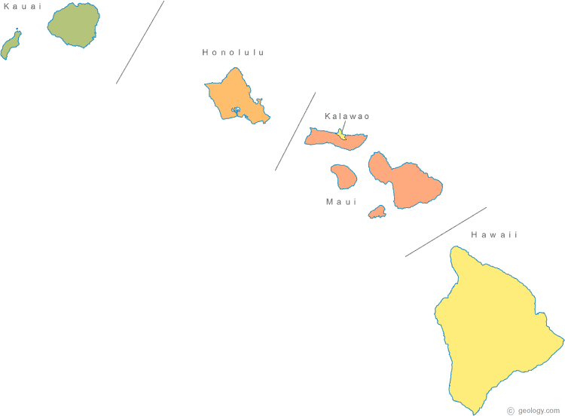
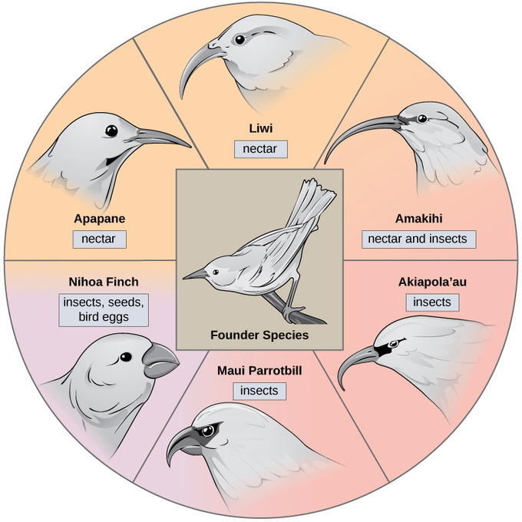
ALLOPATRIC SPECIATION illustrative example: Hawaiian Honeycreepers
55 known sp, most extinct

Slide 5
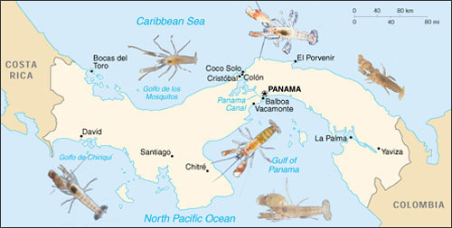
ALLOPATRIC SPECIATION illustrative example: snapping shrimp
Nearly genetically identical after 3 million years of isolation, yet when brought together, they ‘snap’ instead of courting
Notes:
An example of vicariance is the separation of marine creatures on either side of Central America when the Isthmus of Panama closed about 3 million years ago, creating a land bridge between North and South America. Nancy Knowlton of the Smithsonian Tropical Research Institute in Panama has been studying this geological event and its effects on populations of snapping shrimp. She and her colleagues found that shrimp on one side of the isthmus appeared almost identical to those on the other side -- having once been members of the same population.
But when she put males and females from different sides of the isthmus together, they snapped aggressively instead of courting. They had become separate species, just as the theory would predict.

Slide 6
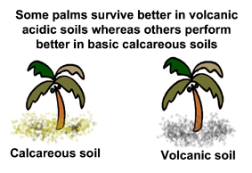

SYMPATRIC SPECIATION
Reproductive isolation despite no geographic isolation
contiguous distribution
temporal response to different soil chemistry
later to flower earlier to flower
Notes:
two species of Howea, endemic to the remote Lord Howe Island, are sister taxa and diverged from each other well after the island was formed 6.9 million years ago³.

Slide 7
SYMPATRIC SPECIATION illustrative example: Cichlid fish
sexual selection > speciation
• In daylight conditions there is a color distinction
• Females mate only with males of their own species
Under orange light, females of both species mate indiscriminately

Slide 8
SYMPATRIC SPECIATION illustrative example: Ensatina salamanders
Interbreed, but reduced offspring viability
Do not interbreed to close the ‘ring’; functionally separate species
Notes:
A ring species

Slide 9
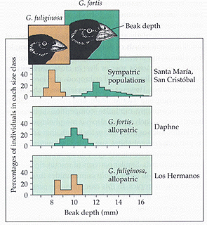
Galapagos finches, again
Sympatric:
same island, different niche
Exploit different seed resources
Allopatric:
different islands, same niche
Exploit same resource

Slide 10
EVOLUTION RATES… differ from group to group differ within a group over time
Gradualism
incremental over time
Punctuated Equilibrium
abrupt, after periods of stasis
Darwin
Eldredge &Gould

Slide 11
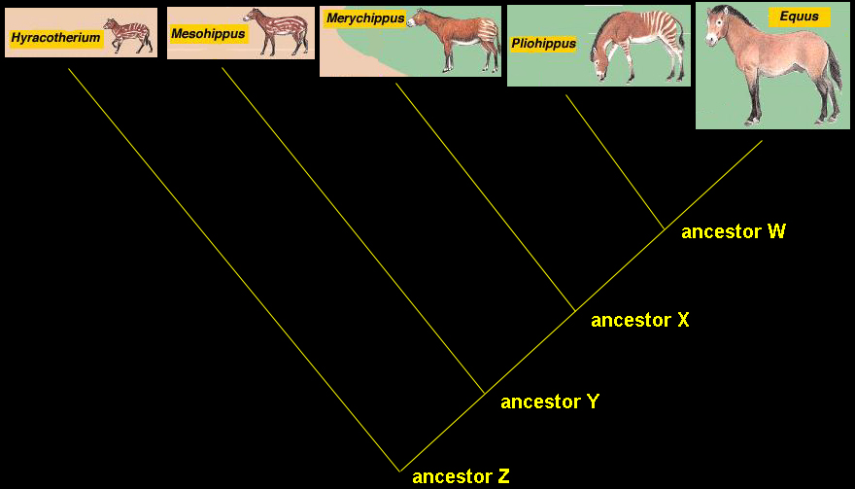
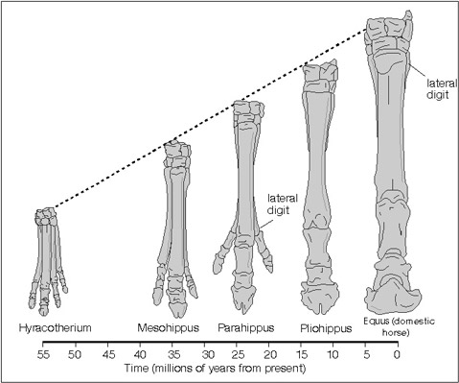
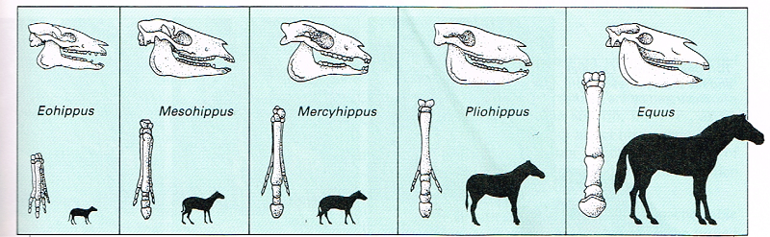
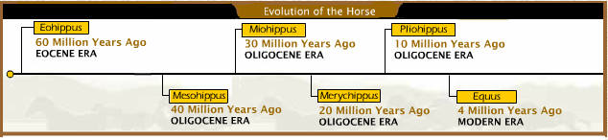
Gradualism: Horse as illustrative example
Teeth: length and

Slide 12
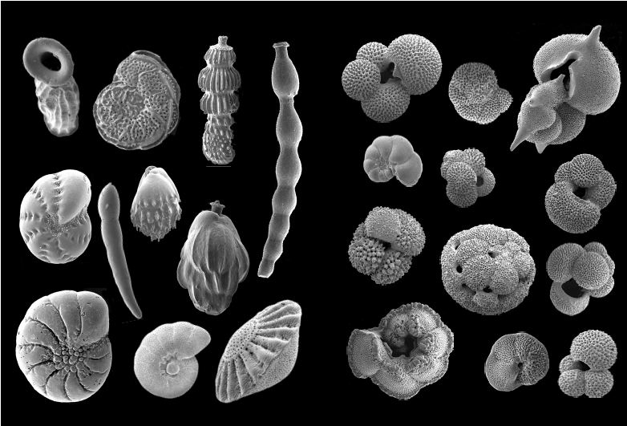
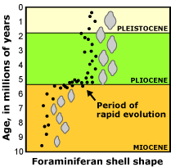
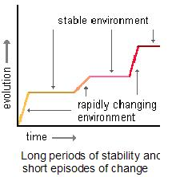
Punctuated equilibrium: Foraminifera
aquatic protists (unicelled eukaryotes) with shells, pseudopodia
benthic forms plankton
Notes:
Mostly marine forms

Slide 13
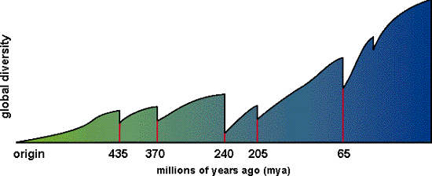
EXTINCTIONS are also EVOLUTION
35%
animal families
50% of life
50% animal fam.
95% marine spp
30% animal families
5 mass extinctions in Earth’s history
Notes:
The five largest mass extinctions in Earth's history occurred during: The late Ordovician period (about 438 million years ago) - 100 families extinct - more than half of the bryozoan and brachiopod species extinct.
The late Devonian (about 360 mya) - 30% of animal families extinct.
At the end of the Permian period (about 245 mya) - Trilobites go extinct. 50% of all animal families, 95% of all marine species, and many trees die out.
The late Triassic (208 mya) - 35% of all animal families die out. Most early dinosaur families went extinct, and most synapsids died out (except for the mammals).
At the Cretaceous-Tertiary (K-T) boundary (about 65 mya) - about half of all life forms died out, including the dinosaurs , pterosaurs, plesiosaurs, mosasaurs, ammonites, many families of fishes, clams, snails, sponges, sea urchins and many others.

Slide 14
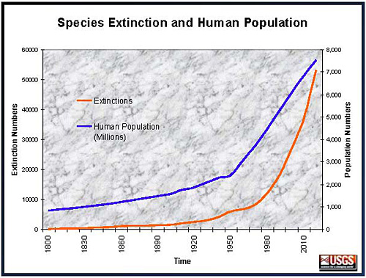
Sixth major extinction is NOW!
Different because:
  - Human origin
  - Exceptional rate of change
Factors:
- climate change
- loss of habitat
- disease
- non-native species
Models predict 75% animal species extinct in 300 yrs

