Slide 1
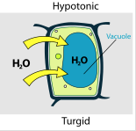
Water Potential Ψ
The tendency of water to diffuse from one sol'n to another
physical pressure
Recall:
• just like solute, water will diffuse from high to low concentration
aka osmosis
• cell walls are rigid and so create resistance to inflow, increasing pressure in a cell
visible as turgor pressure
Notes:
plasmolysis

Slide 2
Analogy: only so many people, (molecules) can fit within the phone booth or VW (cell wall)

Slide 3
Therefore, in cells with walls, diffusion is determined by both factors:
The solute concentration gradient (aka solute potential, osmotic potential, osmolarity, Ψ_{s})
2. pressure in the cell (aka pressure potential, Ψ_{p})
water moves from a sol’n with higher water potential, (Ψ) to the sol’n (cell included) with lower water potential
The water potential of pure water in an open container = 0 (no pressure, no solute)
Ψ_{s}+ Ψ_{p} = Ψ
Notes:
Solute is called osmotic because it drives osmosis

Slide 4
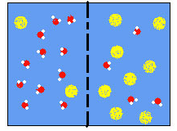
Solute Potential Ψ = Ψ_{s}+ Ψ_{p} aka osmotic potential
solute
Hypotonic
Less solute, more free water
Hypertonic
More solute, less free water
Adding solute lowers solute (osmotic) potential.
Since Ψ of pure water (no solute) = 0, Ψ_{s} is always negative
Notes:
Solutes reduce water potential (resulting in a negative Ψ_{w}) by consuming some of the potential energy available in the water. Solute molecules can dissolve in water because water molecules can bind to them via hydrogen bonds;The energy in the hydrogen bonds between solute molecules and water is no longer available to do work in the system because it is tied up in the bond.
In other words, the amount of available potential energy is reduced when solutes are added to an aqueous system. Thus, Ψ_{s} decreases with increasing solute concentration
Source: Boundless. “Water and Solute Potential.” Boundless Biology. Boundless, 14 Nov. 2014. Retrieved 19 Mar. 2015 from https://www.boundless.com/biology/textbooks/boundless-biology-textbook/plant-form-and-physiology-30/transport-of-water-and-solutes-in-plants-183/water-and-solute-potential-696-11921/

Slide 5
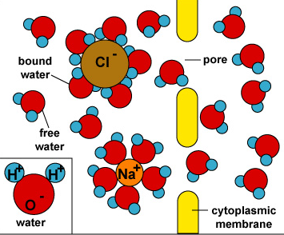
Solute reduces the free energy of water
Water bonds with charged solute
These large complexes are unable to cross the membrane
Fewer ‘free’ water molecules to diffuse across PM
The potential of water to diffuse is lowered by the addition of the solute.

Slide 6
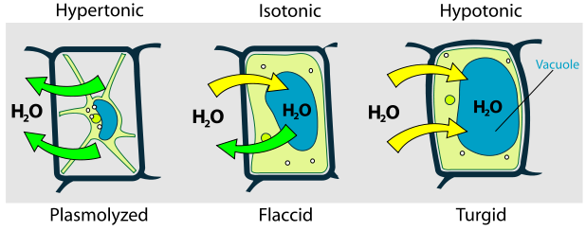
Pressure Potential, Ψ = Ψ_{s}+ Ψ_{p}
• if pressure in cell increases, so does Ψ
• Ψ_{P} can be 0, positive, or negative
ex: 0 for an open container at STP, positive in turgid cells, negative in xylem cells during transpiration
- pressure 0 pressure + pressure
Notes:
Ψp can be positive or negative since the physical pressure can be greater than atmospheric pressure (positive; i.e. in a turgid plant cell) or less than atmospheric pressure (negative; i.e. xylem cells when water is flowing through by transpiration).

Slide 7
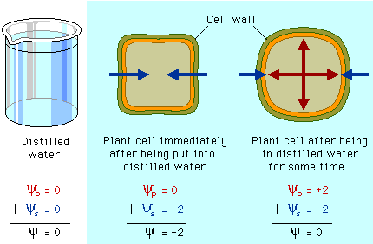
Sum of solute, pressure potentials yields water potential
No solute, no pressure Net diffusion into cell No net diffusion

Slide 8
a cell in distilled water
+2
+1
0
-1
-2
• initially:
solute gradient
no pressure in cell
neg. cell water potential
net diffusion into cell
x
•
x
t=0 t=60
x
X at 60 minutes :
cell solute is more dilute
pressure increased
zero water potential equilibrium
no net diffusion
•
•
Ψ =
Ψ_{s}
+ Ψ_{p}

Slide 9
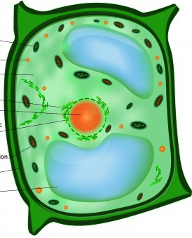
DI in beaker in cell
none some
hypo- hyper-
from into
0 negative
0 negative
0 increasing
higher lower
solute
-tonicity
direction of osmosis
+ - 0
solute pot.
+ - 0
osmotic pot.
+ - 0 pressure pot.
water potential

Slide 10
Practice
Problems #13 and 14 (Model 4) of the POGILish
More:
• If a plant cell’s Ψ_{P} = 1.5 bars and its Ψ_{S} = -4.0 bars, what is the resulting Ψ?
Notes:
3. The original cell from question # 1 is placed in a beaker of sugar water with Ψ_{S} = -0.15 MPa (megapascals). We know that 1 MPa = 10 bars. In which direction will the net flow of water be?

Slide 11
To quantify water potential, first determine solute potential:
Ψ_{s} = -iCRT
temperature
K = C + 273
pressure constant
.0831 L bars/moles K
ionization factor
sucrose does not
ionize in water
i = 1.0
molar concentration
moles/L
cancel units: moles, L, K
answer is in bars
• Then consider pressure: Ψ_{p} = zero in an open container
• Finally, sum them: Ψ_{s +} Ψ_{p =} Ψ
Notes:
Pressure is simply force per unit area, and in physics is expressed as Newtons / m².
1 atmosphere = 14.7 lbs/in² or 760 mm Hg or 1.013 x 10⁵ N/m²
This is equivalent to the pressure of 10.35 meters of water.
In plant physiological work, we don't usually use the above units, but go metric, with either bars or megapascals (MPa).
1 bar = 14.5 lbs/in² or 0.9869 atmospheres or 10.22 m of water.
1 Mpa = 10 bars or turned around, 0.1 Mpa = 1 bar

Slide 12
Example
Ψ_{s} = -iCRT
temperature
K = C + 273
ionization factor
pressure constant
.0831 L bars/moles K
sucrose does not
ionize in water
i = 1.0
molar concentration
moles/L
Ψ_{s} = -(1)(1.0)(.0831)(295)
Ψ_{s} = - 24.51 bars
Ψ = - 24.51 bars + Ψ_{p}
Ψ = - 24.51 bars
Ex: solute potential of a 1.0M
sucrose sol’n at 22C at :
std atmospheric pressure

Slide 13
Practice
Problems #11, 12, (Model 3)of the POGILish
Ψ_{s} = -iCRT
temperature
K = C + 273
ionization factor
pressure constant
.0831 L bars/moles K
sucrose does not
ionize in water
i = 1.0
molar concentration
moles/L
More:
• Find the solute potential of a 0.5M glucose sol’n at 37C and standard atmospheric pressure
Notes:
Ψ_{s} = -(1)(0.5)(.0831)(310)
Ψ_{s} = -12.88bars
Ψ = -12.88bars + Ψ_{p}
Ψ = -12.88bars

