Slide 1
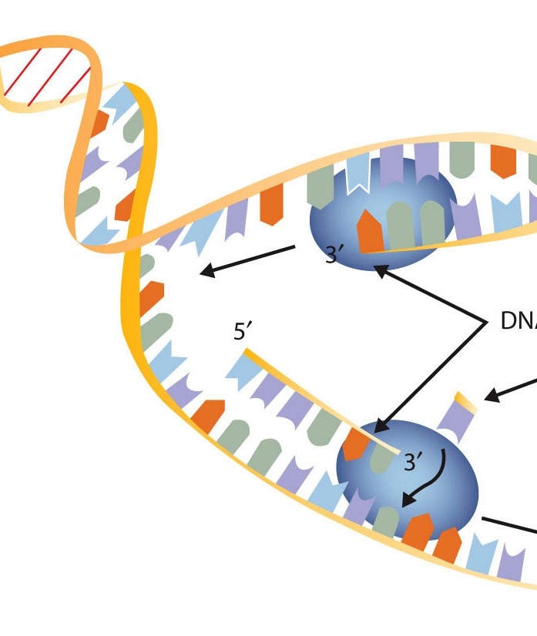
Label: • 3’ 5’ ends of all strands • topisomerase, helicase, ligase, polymerase
• Direction of replication fork, leading strand • , lagging strand, Okazaki fragments
• H bonds, covalent bonds • old strands, new strands

